Slide 1

VeCan or VeCan’t
Restaurant finder: Vegan/Vegetarian Friendly
Nabor Reyna

Slide 2

Challenge
Using Yelp restaurant review data
Can we find Vegan/Vegetarian friendly dinning options

Slide 3
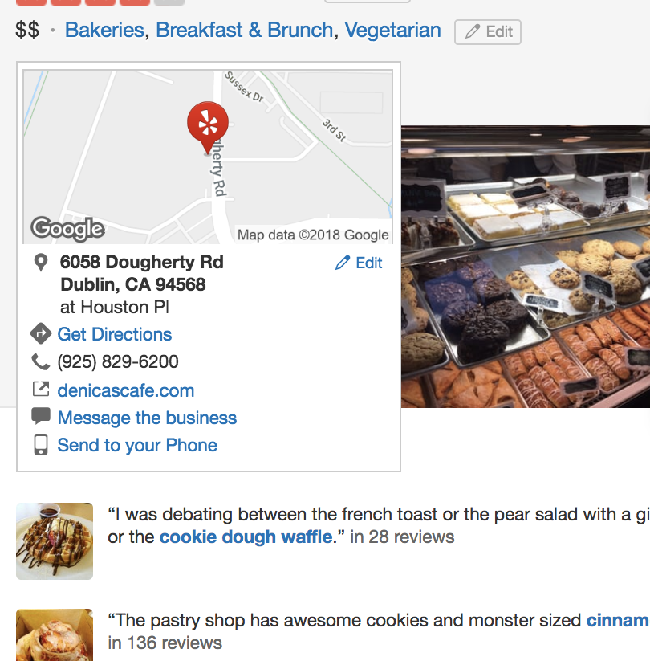
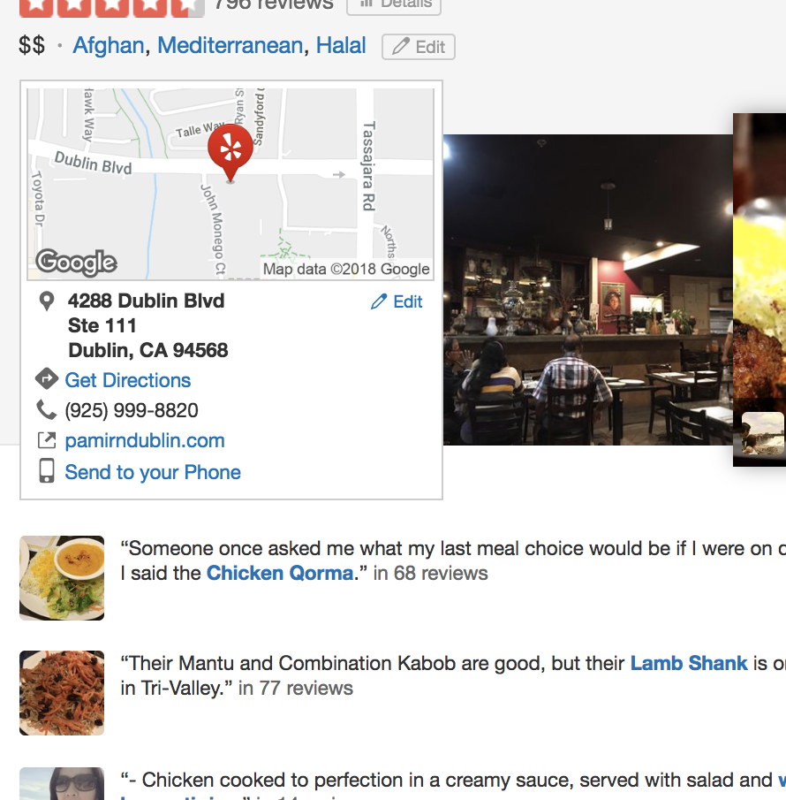
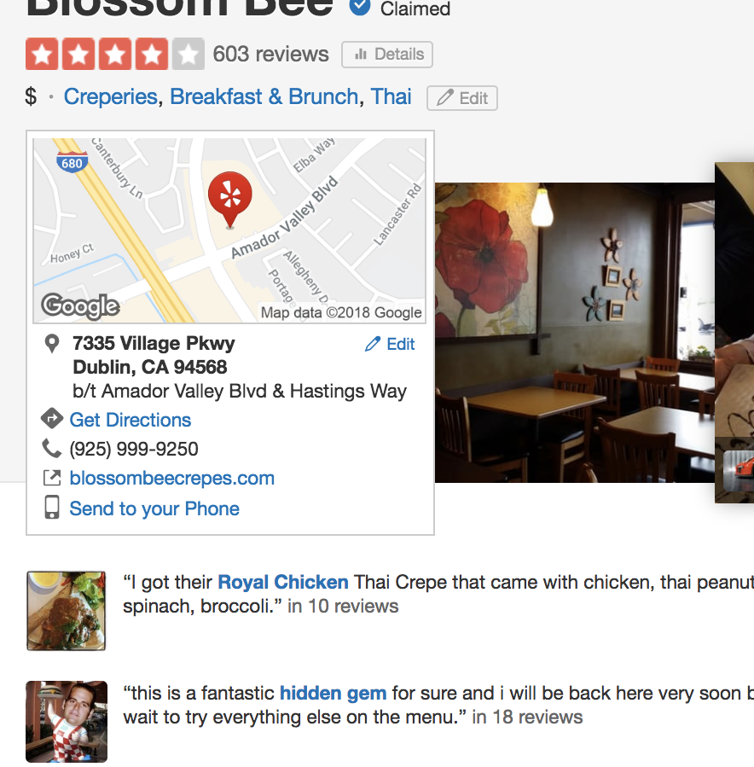
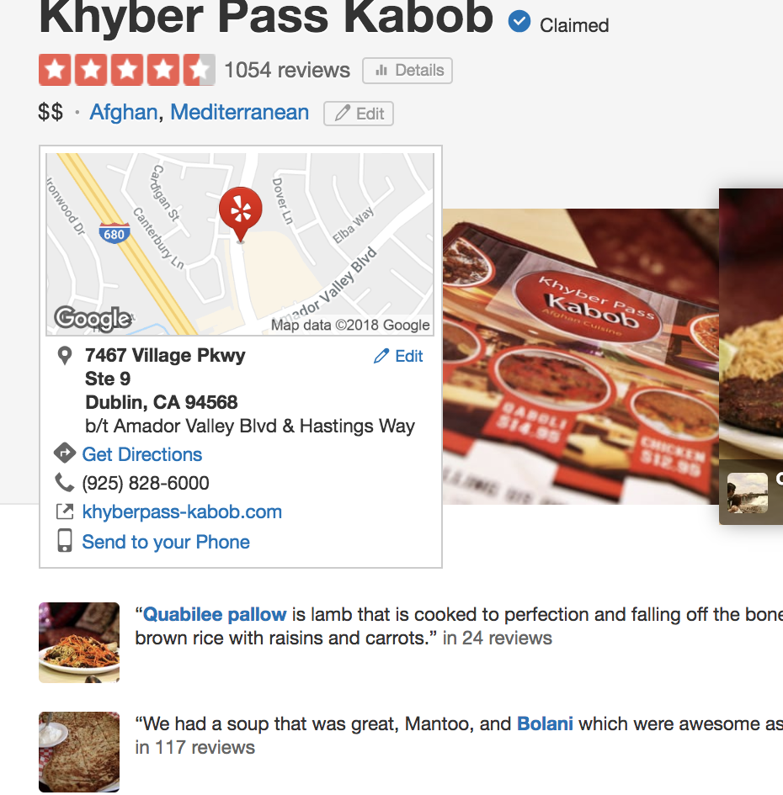
What’s for dinner?
Commence the endless search through restaurant reviews

Slide 4

Data
Yelp Challenge Data Set
DB Access to 5 million reviews
Extracted 1.1MM rows for project
5 cuisines (US only)
Data Flag – Vegan/Vegetarian

Slide 5
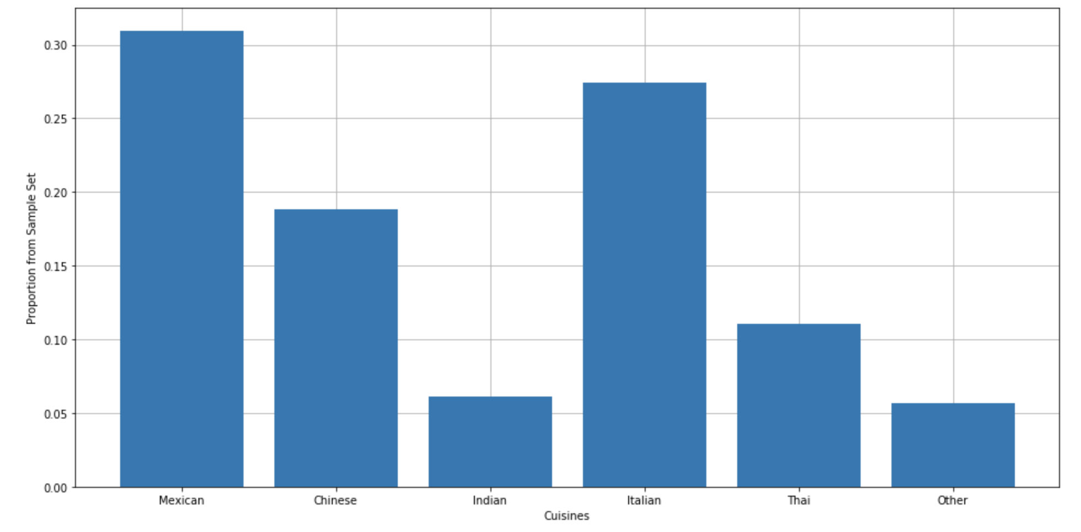
Data Distributions
Veggie Friendly by cuisine

Slide 6
Models
Naïve Bayes
Random Forest
KMeans

Slide 7
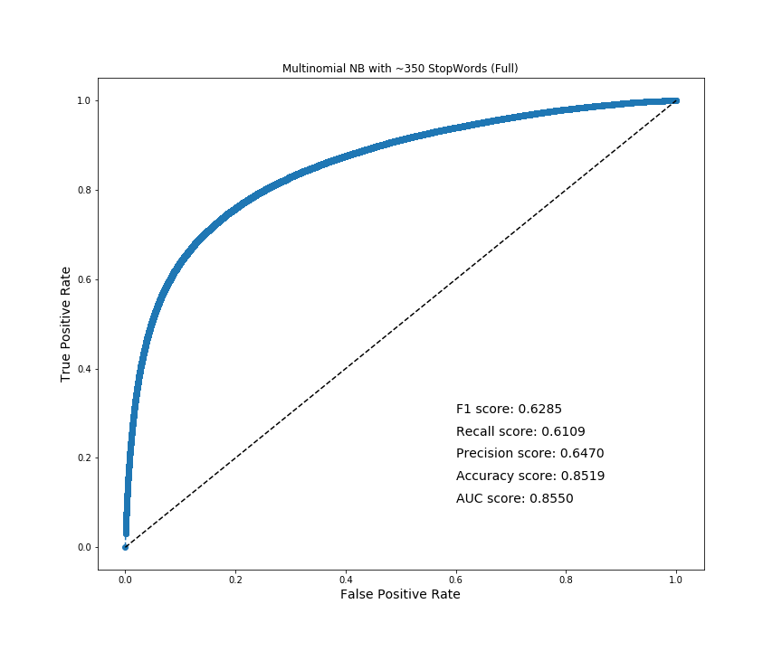
NB Results
I know everything!
Any questions?
Notes:
MNB_357StWds_full_countV.png

Slide 8
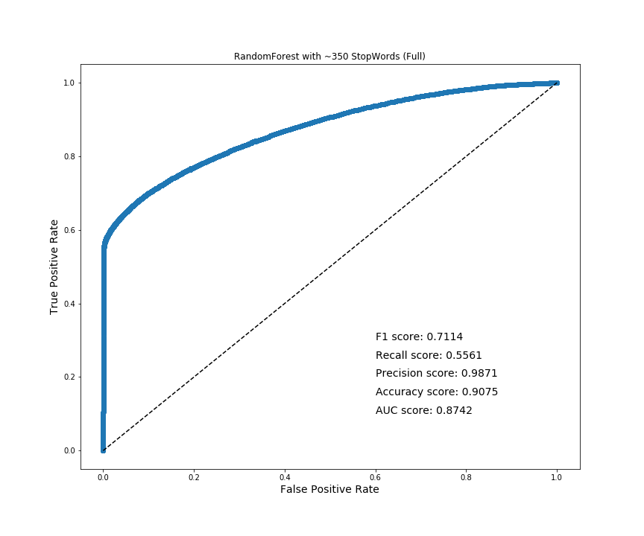
RF Results
I know everything!
Any questions?
Notes:
MNB_357StWds_full_countV.png

Slide 9
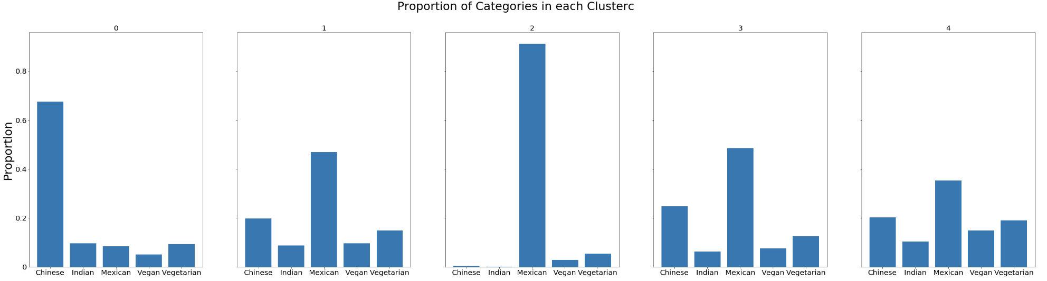
KMeans Results
Not able to create meaningful clusters
Notes:
MNB_357StWds_full_countV.png

Slide 10
False Positive
Reviews NOT tagged as 'Veggie Friendly’
but PREDICTED that they are.
It seems that the reviews here speak about the food more than about the establishment, which helps the model fish out establishments that are 'Veggie Friendly'.
We were able to find Veggie-Freindly places without a tag.

Slide 11
False Negatives
Reviews - tagged as 'Veggie Friendly’
but PREDICTED as not being 'Veggie Friendly’.
It seems that the reviews here don't speak about the food, but more so about the establishment.

Slide 12


Future Directions
Pivot Data:
Create a corpus of reviews for a business/tags
Go eat!

